Slide 1

Welcome To Predictive Analytics
Justin Grosz

Slide 2
Today’s Agenda
Class Format
Intro To Jupyter Notebook
Nearest Neighbors
In Class Work

Slide 3

Class Format

Slide 4
Overview of this semester’s work
Class Is Broken Up Into Learning 5 Predictive Models With Assignments For Each
Nearest Neighbors
GLM (Linear/Logistic)
Decision Trees (Decision Tree Based)
Neural Network
Capstone Project To Close Out The Class

Slide 5
Class Expectations
Applying Machine Learning Techniques To Real World Situations
Understanding When To & When Not To Use Machine Learning
When To Use A Particular Model
How To Compare Models
Applying Model Results To Make Business Decisions
Understand How Our Results Impact The Business
Become Translators To Stakeholders

Slide 6
Tools to use & learn
Open To Use Python Or R To Complete Work
In Class Examples Will Be In Python
If You Haven’t Downloaded Jupyter Notebook, Do So ASAP
All Work Must Be Done In One Of Those Two Languages
No Excel Editing
Become Very Good At “Googling”
To Become The Best Data Scientist Or Engineer, It Is Not About How Much You Know, But It’s About Knowing Where To Look
Stack Overflow & Medium Articles Should Be Flooding Your Tabs On Your Laptop

Slide 7
Intro To Jupyter Notebook

Slide 8
Jupyter Notebook
An Interactive Notebook That Allows You To Document, Edit, & Run Python Code
Make Sure You Are Using Python 3.8
We Will Use It Because It Is Easy To…
Show What The Code Is Doing In Steps
Take Notes To Understand What Procedures Are Doing
See Results Instantly

Slide 9
Downloading jupyter Notebook
Download Python First (3.6 – 3.8 is fine)
https://www.python.org/downloads/
Install Anaconda
Anaconda Individual Edition
Once Downloaded, On Your Computer, You Should Have Anaconda Navigator
There You Should See Jupyter Notebook
Quick Tutorial

Slide 10
Data Prep

Slide 11
Modeling Basics – Data Cleansing
Data Cleansing
Before We Model We Must Make Sure That Are Data Is Clean
Take Care Of Missing Values
Just Getting Rid Of Them IS NOT AN OPTION WITHOUT INVESTIGATION
Mean
Median
Mode (tricky and not ideal for numerical values)
Imputation (such as Nearest Neighbors Imputation)
Make Sure Columns Are Clear (Or At Least You Understand What They Mean)
Use Data Dictionary (if available) To Clean Up Data
May Guide You To Whether You Can Delete Values Or Replace With Mean Value

Slide 12
Modeling Basics – Data Investigation
Data Investigation
We Should Investigate Our Variables Before Modeling. Here Are A Few Things To Check
Distribution of Values: Normal or Skewed
Outliers: Do we have values that are extraordinarily large/small
Data Types: Are my data points classified to the right “type”
This Is Crucial Since This May Lead You To More Data Cleansing To Get The Best Results

Slide 13
Modeling Basics: Data Split
Train/Test
Split Data Into Two Datasets
Need To Build The Model Then Test It On An Unexposed Group
Doesn’t Have To Be Overly Scientific
80/20 Is The Normal Rule
80% of data goes into training & 20% goes to test
Probably Wouldn’t Go Past 70% to 30%

Slide 14
Nearest Neighbors

Slide 15
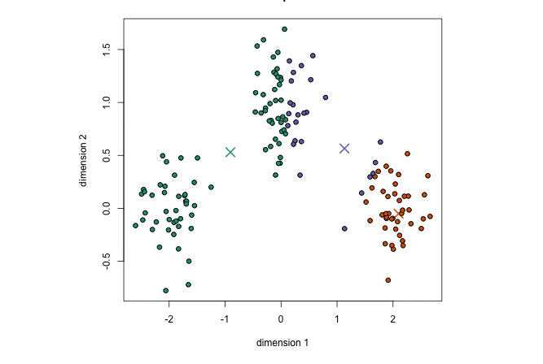
Clustering
The introduction to Predictive Analytics
Supervised & Unsupervised
Visual Based
Non Complex Setup
One of the first business go to’s for seeing differences
Segmentation
Can we classify customers by their behavior?
Do projects have different outcomes?

Slide 16
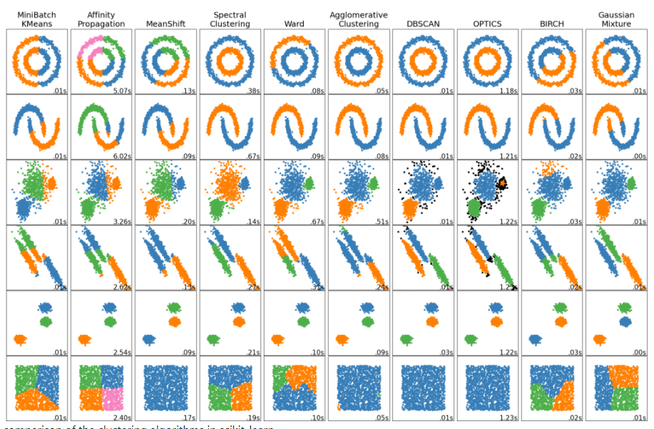
Many Types Of Clustering
Use Cases For Different Clustering Methods
How Do You Want To Find Groups (Dense or Space)
How Much Data Are You Using
How Do Points Shape (Circular, Line)
Dynamic Or Static Clustering (Mean or Shifting Value To Center)

Slide 17
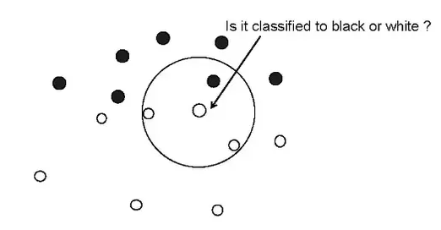
Intro To Nearest Neighbor Algorithm
More Commonly Known As Lazy Learning
Algorithm Uses Distance To Dictate How To Label Values
Most Common Version Is Called K-Nearest Neighbors
K -> How Many Neighbors Will We Look At
How Do We Calculate “Distance”
Think about previous slide

Slide 18
Euclidian
Multiple Methods To Calculate Distance, But Most Common Is Using Euclidian
To Calculate Euclidian Is To Simply Find The Absolute Value Between Two Points
Gets A Bit More Complicated Based On Dimensions
1 Dimension: Point A=3 , Point B=6. Distance = 3
2 Dimension: Point A=(3,6), Point B= (1,7)
(y2-y1)^2+(x2-x1)^2

Slide 19
Clustering Process
Select Number Of Classes (i.e K=3).
Model Starts Looking For 3 (or your K value) Mean Points
Each Point Is Computed Against Each Mean Point
Data Is Classified

Slide 20
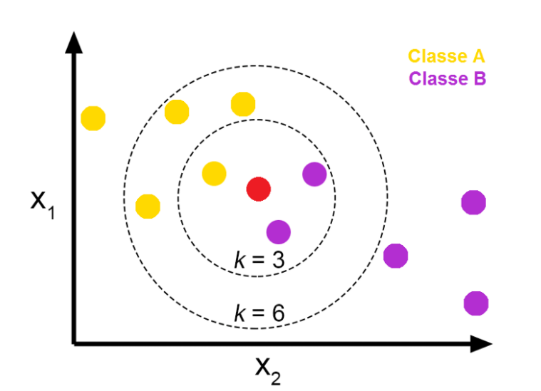
What Does The K Mean in K-Nearest Neighbors
K -> How Many Voters Are We Going To Have
What Is The Answer To K=3
What Is The Answer To K=6
Are The Answers Same Or Different

Slide 21
Problems That KNN Can Solve
KNN Can Be Used When Trying To Predict Binomial, Classifiers & Numeric Variables
Some Models That We Will Look At This Semester May Only Be Good At Doing 1 or 2 of 3
Wouldn’t Really Suggest For Regressor
Examples
What Type Of Clothing Is This? (Classifier)
Is This A T-Shirt? (Binomial)
How Many T-Shirts Do We Expect To Sell (Regressor)
When We Are Using KNN, We Will Need To Decide Which Of The 3 We Are Trying To Solve

Slide 22
KNN Weaknesses
Doesn’t Handle Categorical Variables Well
Convert Variables To Dummy Variables But Can Be Tedious
Not Great On Large & Wide Data Sets
Even Though KNN Can Be Efficient, It Has A Steep Decline As Data Scales (Focuses On Mean Points & Doesn’t Shift)
Think How KNN Predicts
The More Variables & Data -> More Voters & More Size = Less Performance

Slide 23
KNN Analysis
How Do You Have Takeaways From Your KNN Analysis
Research Why These Points May Be Grouped Together
Exploratory research such as looking at histograms of their distributions or Box & Whisker Plots To See If Their Values Group Differently
Accuracy
How many of the points that you put into the algorithm, actually came out correct.
Does This Provide Me With Insight?
Did I find a useful group or segmentation?
Were my results better than guessing?
Would I suggest that a business make financial or societal based decisions based off the results?

Slide 24
In Class Example

Slide 25
Loading data
import numpy as np
from sklearn import datasets
import matplotlib.pyplot as plt
from mpl_toolkits.mplot3d import Axes3D
from collections import Counter
iris = datasets.load_iris()
iris_data = iris.data #separate training variables
iris_labels = iris.target #what we are predicting

Slide 26
Train/test
np.random.seed(42) #randomize data
indices = np.random.permutation(len(iris_data))
n_training_samples = 12
trainset_data = iris_data[indices[:-n_training_samples]]
trainset_labels = iris_labels[indices[:-n_training_samples]]
testset_data = iris_data[indices[-n_training_samples:]]
testset_labels = iris_labels[indices[-n_training_samples:]]

Slide 27
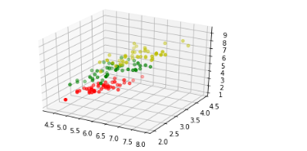
Visualize
X = []
for iclass in range(3):
X.append([[], [], []])
for i in range(len(trainset_data)):
if trainset_labels[i] == iclass:
X[iclass][0].append(trainset_data[i][0])
X[iclass][1].append(trainset_data[i][1])
X[iclass][2].append(sum(trainset_data[i][2:]))
colours = ("r", "g", "y")
fig = plt.figure()
ax = fig.add_subplot(111, projection='3d')
for iclass in range(3):
ax.scatter(X[iclass][0], X[iclass][1], X[iclass][2], c=colours[iclass])
plt.show()
#the colors reprsent the species
#we can see that we have three separate clusters and partially how they differentiate from each other

Slide 28
Calculate Euclidian Distance
def distance(instance1, instance2):
instance1 = np.array(instance1)
instance2 = np.array(instance2)
return np.linalg.norm(instance1 - instance2)

Slide 29
Loop Through Dataset To Calculate Distance
def get_neighbors(training_set,
labels,
test_instance,
k,
distance=distance):
distances = []
for index in range(len(training_set)):
dist = distance(test_instance, training_set[index])
distances.append((training_set[index], dist, labels[index]))
distances.sort(key=lambda x: x[1])
neighbors = distances[:k]
return(neighbors)

Slide 30
Create a voting system
def vote(neighbors):
class_counter = Counter()
for neighbor in neighbors:
class_counter[neighbor[2]] += 1
return class_counter.most_common(1)[0][0]

Slide 31
How Did our model do
for i in range(n_training_samples):
neighbors = get_neighbors(trainset_data,
trainset_labels,
testset_data[i],
3,
distance=distance)
print("index: ", i,
", result of vote: ", vote(neighbors),
", label: ", testset_labels[i],
", data: ", testset_data[i])

Slide 32
Homework

Slide 33
Weekly assignment (Due Thursday)
In this midweek assignment you code and interpret a nearest neighbors algorithm that classifies Iris’s (flower) using the following dataset. This is a common use case for nearest neighbors. You use multiple attributes of the flowers to decide which type of Iris they are. Analyze the data set, and answer the following.
What was the overall accuracy of the model?
What was the accuracy of each type of iris?
Would you classify the model as a good model or not? Think About The KNN Analysis Slide

Slide 34
Weekly Assignment (Final Assignment)
Problem:
We have been given census data about attributes of US citizens (occupation, education, gender, race). With organizations working to ensure equal pay, we want to build a model to see how accurately we can classify low income from high income citizens. Building this model will allow us to understand which attributes contribute to affluency and how we can improve policies in the US.
Part 1:
Use proper data cleansing techniques to ensure that you have the highest quality data to model this problem. Detail your process and discuss the decisions you made to clean the data. This should be inclusive of all columns that needs to be modified due to errors/missing data.
Part 2:
Build a nearest neighbors model with the given data. Then do the following
How did you determine the value of K that you went with. What other values of K did you test with. How did different accuracy measures compare.
Do you believe the model is accurate enough to use in the real world.
Come to a final conclusion about the model. Discuss key learnings from Part 1 and the model itself. Here is where you should use facts from your research to have a concluding story about your work.

